Slide 1

PROJECT-2 28 NOV 2021
ADVISOR
MR Assad
MR Fawzi
GROUP MEMBERS
Houryah
Taghreed

Slide 2
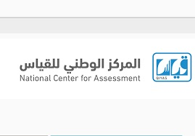
Contents
1- Introduction
2- To do lost
3- Project tools
4- Future vision
5- Results
6- Conclusion

Slide 3

Introduction
​​​​​​​​​​​​​​Our project about Qias and this program Aim to Educational tests presented by the center, are considered the most important tests that are being developed, and they consist of two sections : The verbal and the quantitative. These tests focus on student's analytical and deductive skills, in order to help them assess their learning capacity.
We using ( React , Node JS , Express JS , API , Css and Bootstrap react )

Slide 4
To do list
•Prepare Data
•Working on Back-End
•Sing in
•Sing up
•Home Page
•Website
•Dashboard
•Permissions Page •Working on Front – End •Sing in
•Sing up
•Home Page
•Website
•Dashboard
•Permissions Page
•Hhouryah
•Tagreed

Slide 5
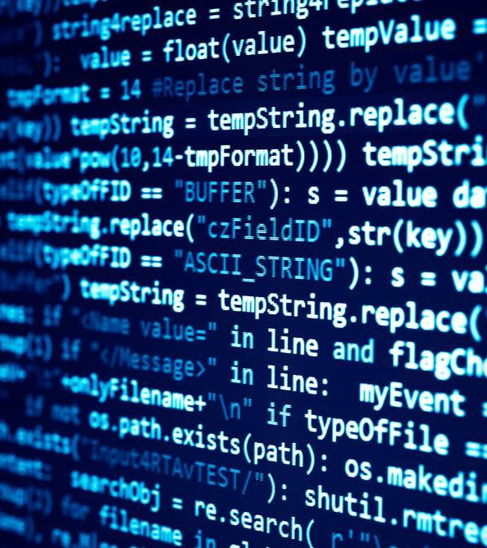
Project tools
VS code
To desing Front-End and program Back-End
Postman
To test out API

Slide 6
Future vision
1- Results are immediate
2- The possibility of conducting the test remotely
3- Using artificial intelligence to avoid cheating

Slide 7
Results
At the end of our project, we were able to learn to link and coordinate the contents to avoid any interference that might harm the program and to try to present it in the easiest way.

Slide 8
conclusion
In conclusion
The project helped us to install the code base and develop our skills with the ability to combine structuring and design by using ( React , Api , Node JS , Express JS ) and Help us develop our thinking skills and build team spirit

Slide 9

Thank you all for your attention

